Slide 1
Inferencing superspreading potential using zero-truncated negative binomial model: exemplification with COVID-19
Gwangwoo Kim
Feb. 24, 2023

Slide 2
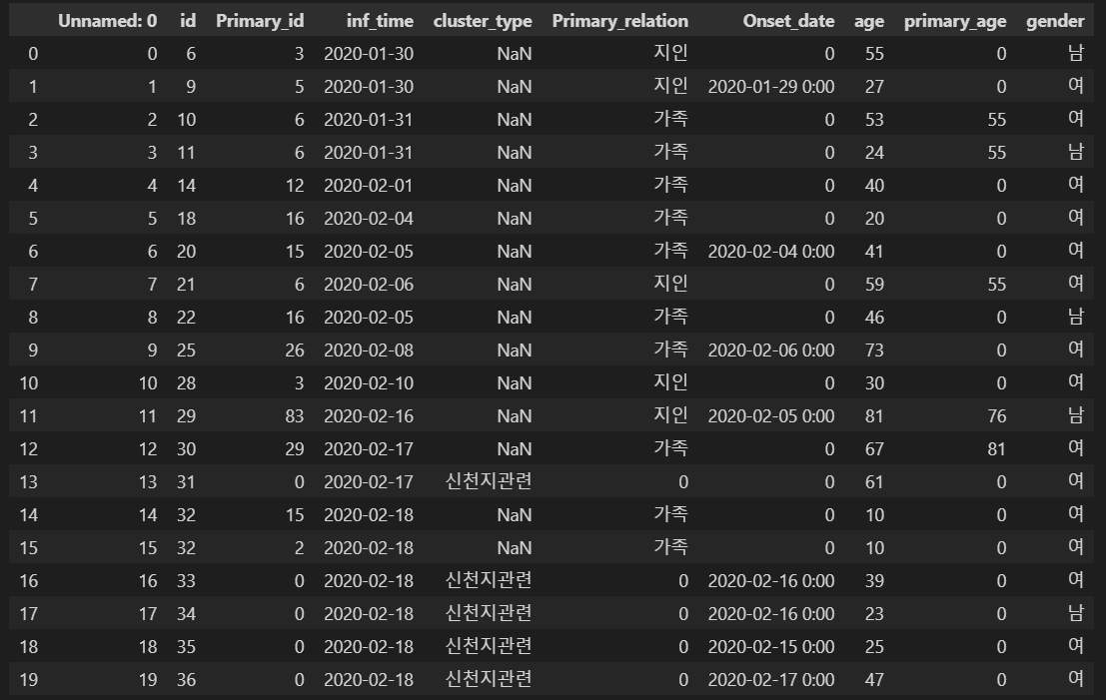
Introduction

Slide 3
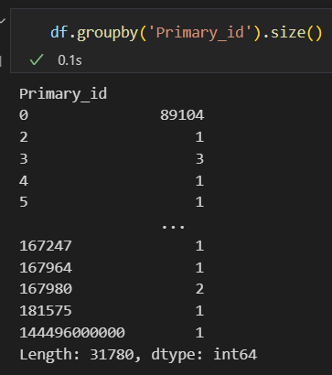
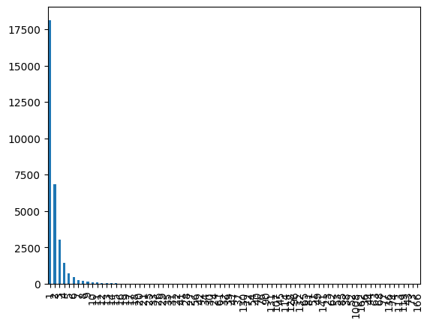
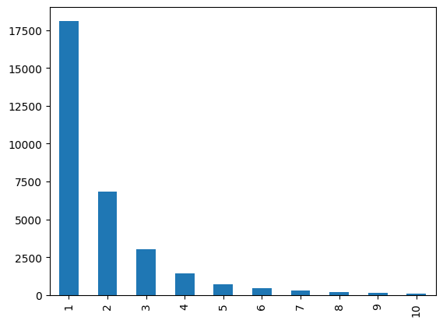
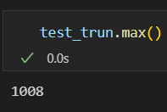
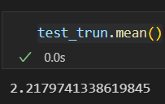
Data summary

Slide 4
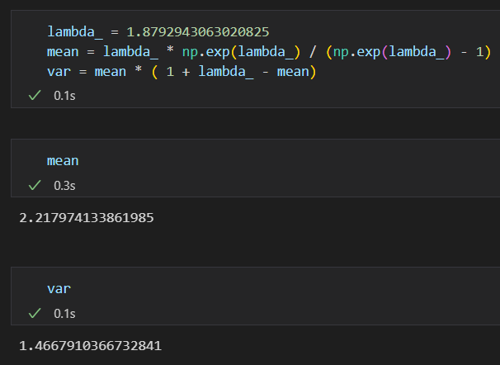
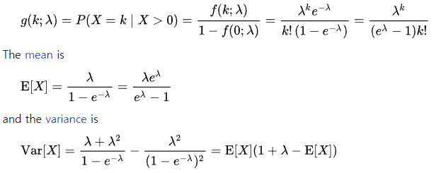
Zero-truncated Poisson distribution

Slide 5
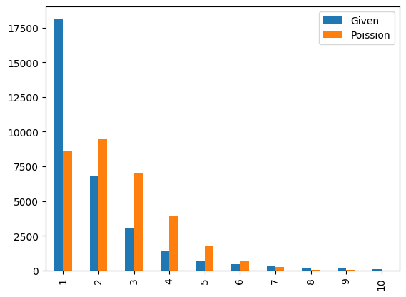
Zero-truncated Poisson distribution

Slide 6
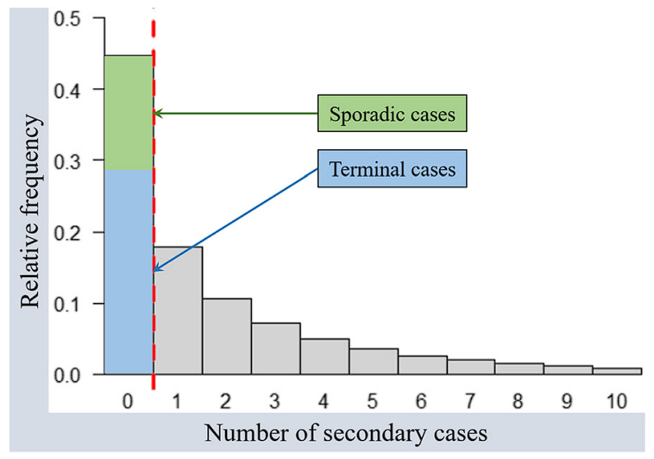
Introduction
The sporadic cases were those without known epidemiological link
The terminal cases were those with known epidemiological links but have 0 secondary case generated.

Slide 7
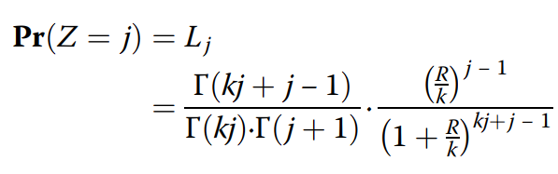
Heterogeneity of individual infectiousness
the mean number of offspring infectee generated by an infector
the number of offspring infectees generated by each infector

Slide 8

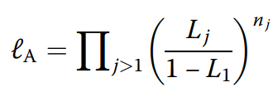
Likelihood-based inference framework and simulation scheme
Non-truncated version
Zero-truncated version

Slide 9
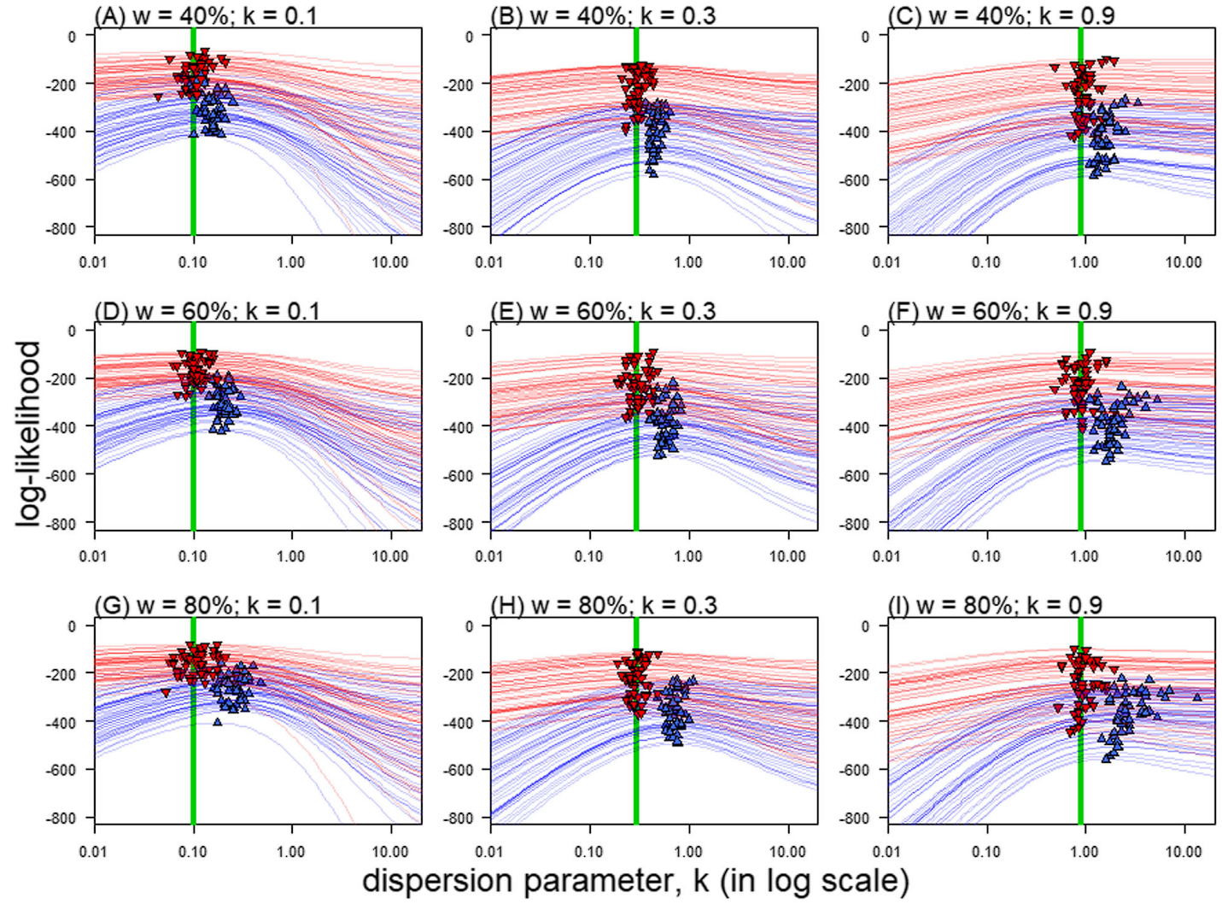
Simulation framework

Slide 10
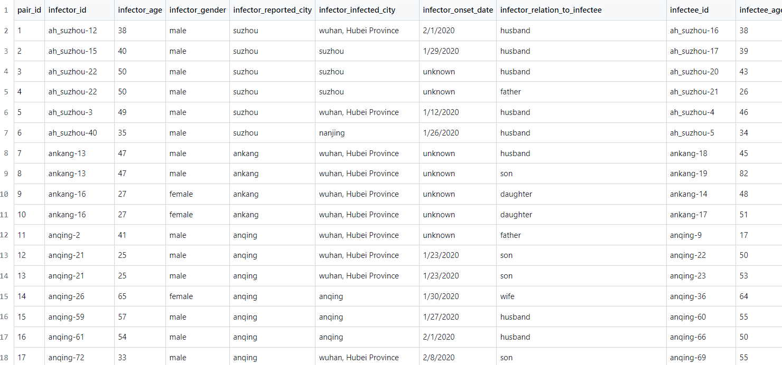
Datasets for exemplification

Slide 11
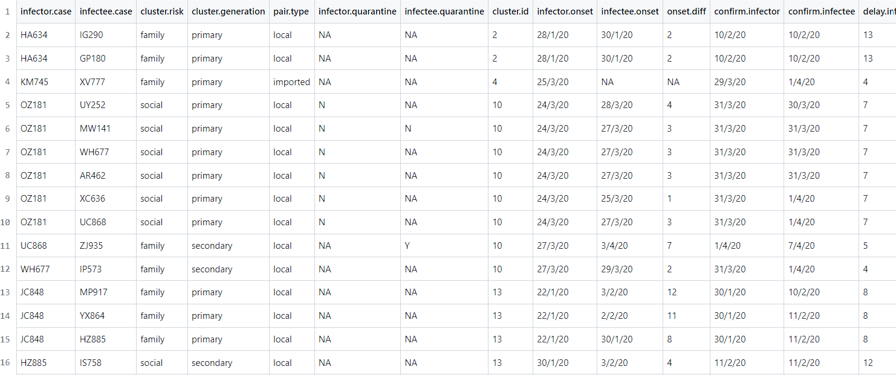
Datasets for exemplification

Slide 12
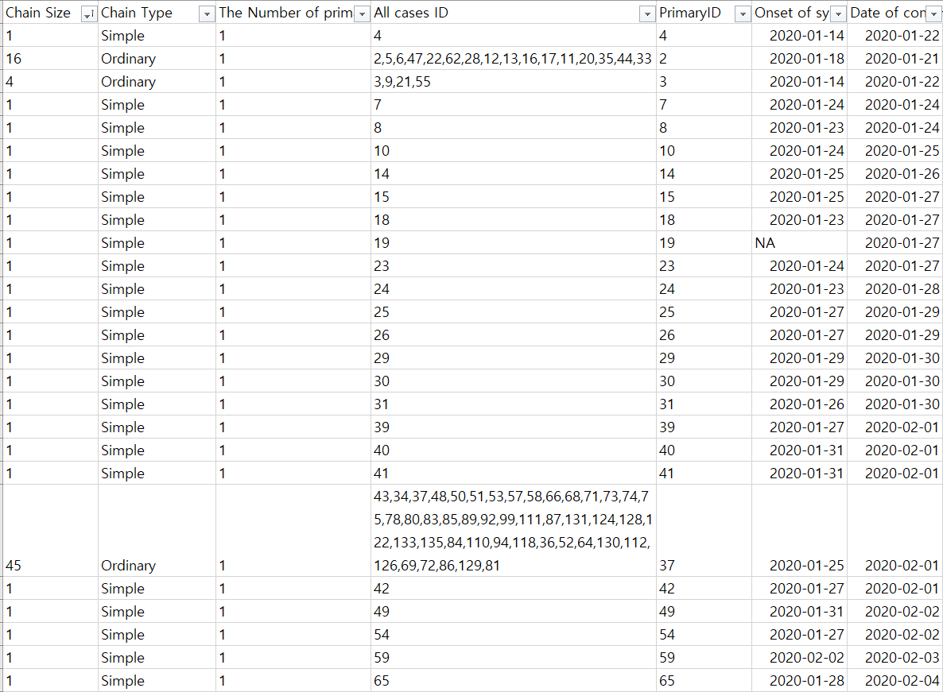
Datasets for exemplification

Slide 13
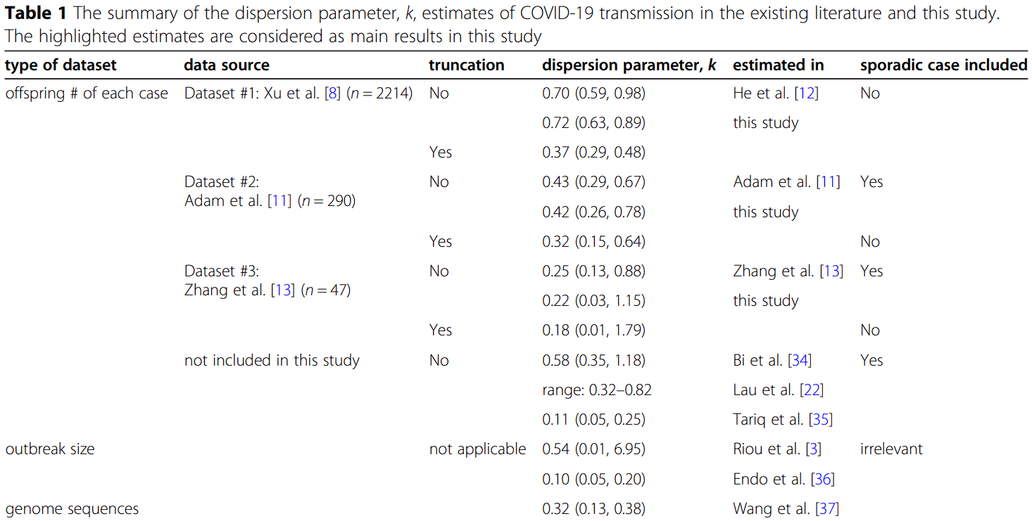
The summary of the dispersion parameter

